Slide 1
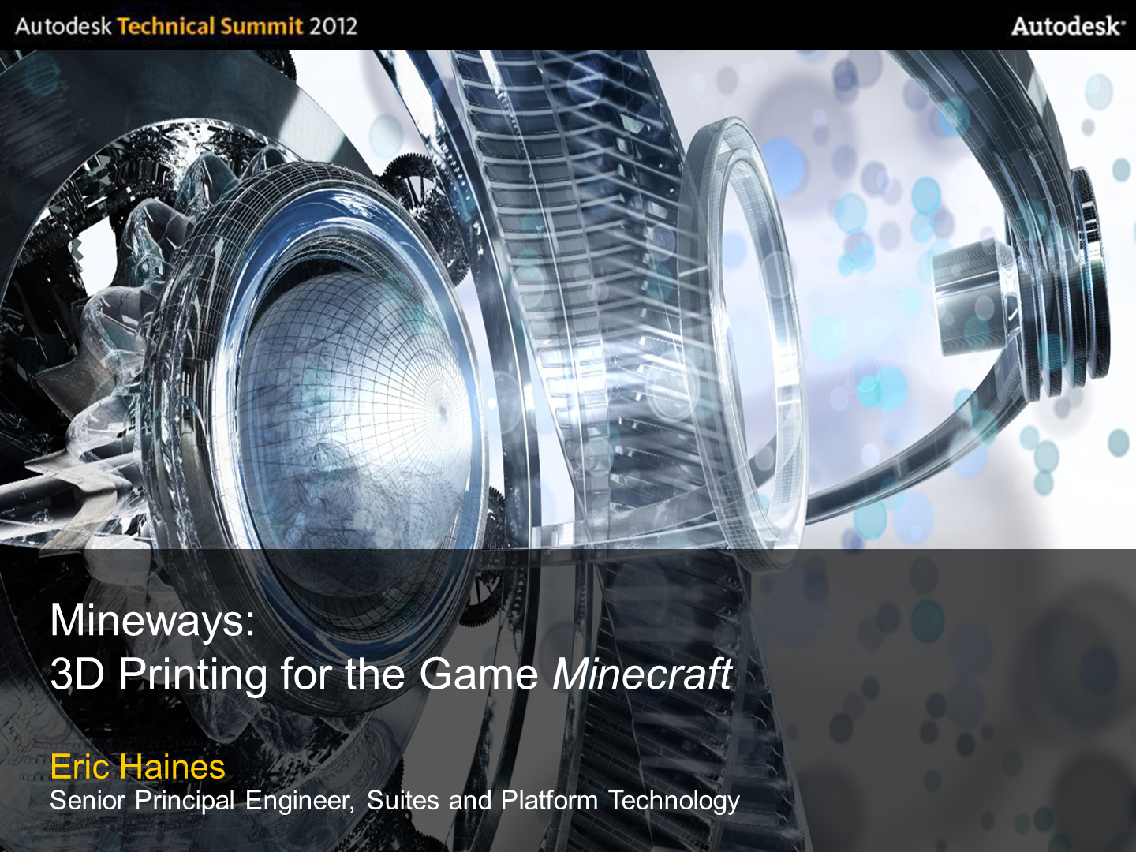
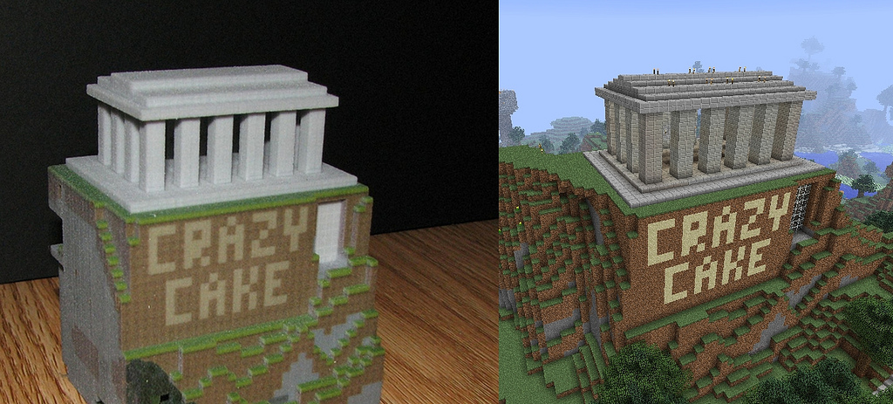
Mineways:
3D Printing for the Game Minecraft
Eric Haines
IPG – Suites and Platform Technology

Slide 2
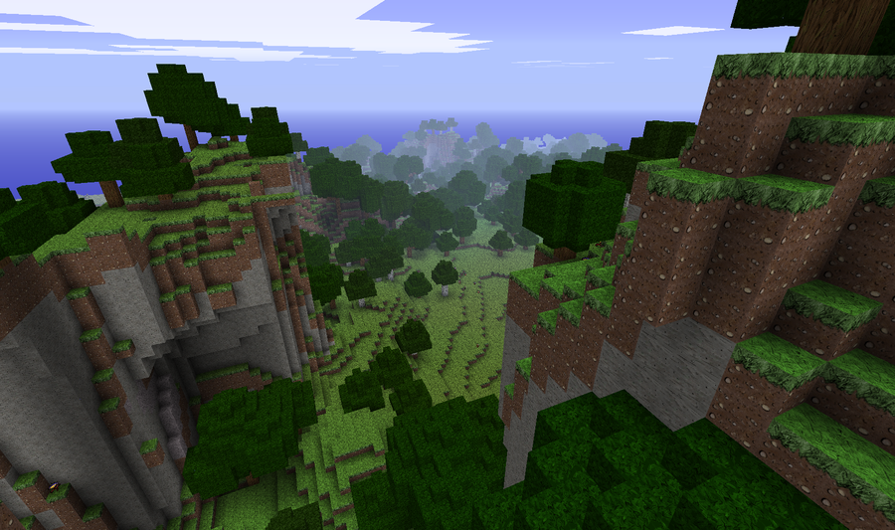
What’s Minecraft?
A computer game. You start in an undeveloped world.
Notes:
First, how many people know what Minecraft is?
World is procedurally generated, no two alike.

Slide 3
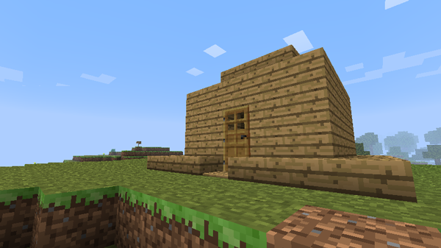
What’s Minecraft?
Everything is modifiable. You can build a house…

Slide 4
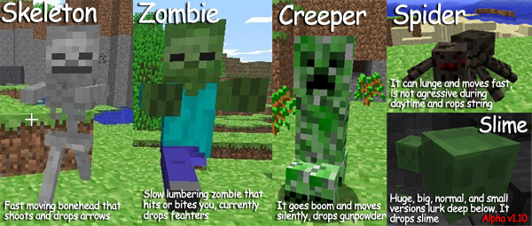
What’s Minecraft?
…to protect yourself from monsters.
But lots of people just build...
Notes:
If the game was mostly about the monsters, it would be pretty dumb, circa 1980’s

Slide 5
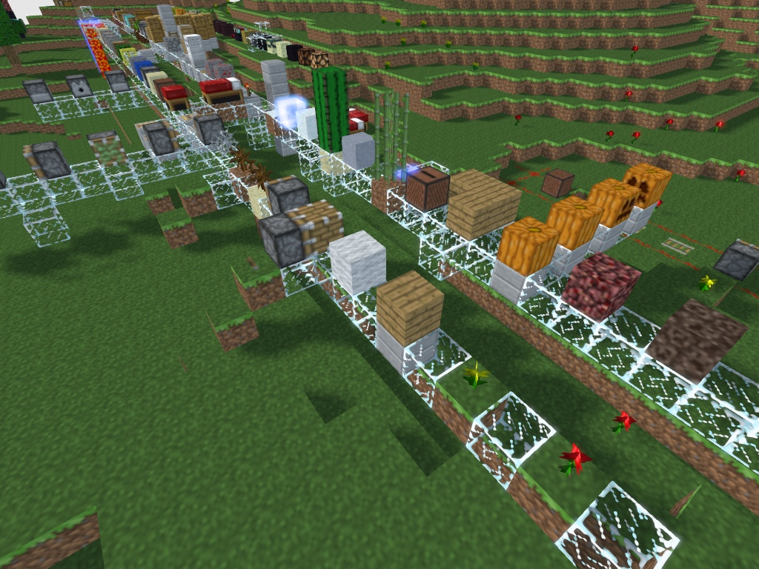
Many Block Types
Notes:
There are hundreds of block types, many with special physical properties

Slide 6
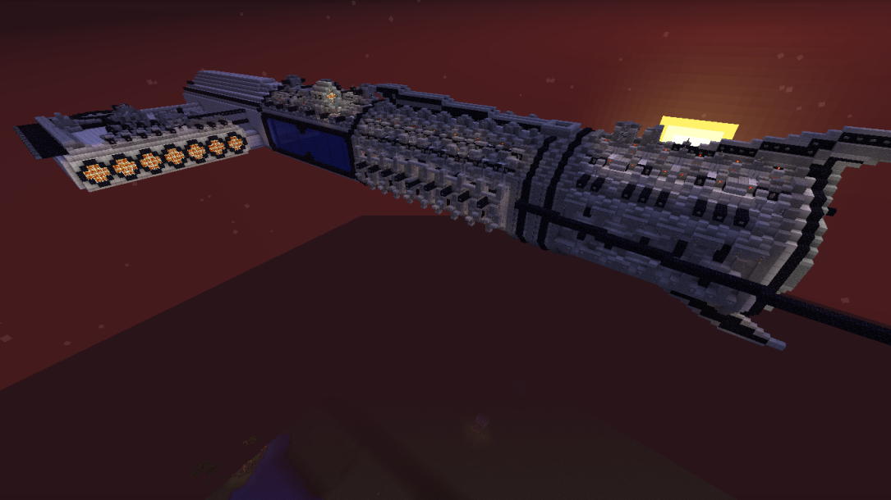
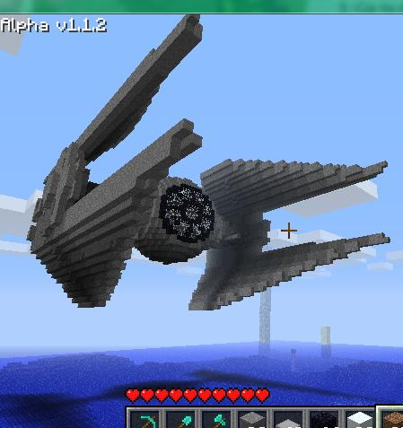
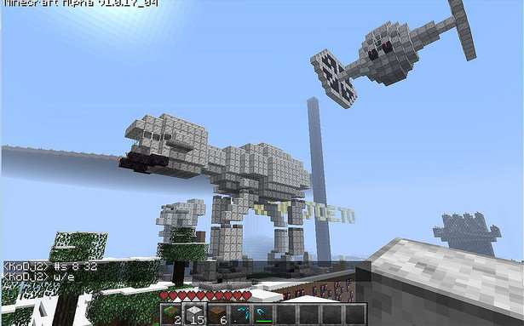
Things Built
Starships, for example

Slide 7
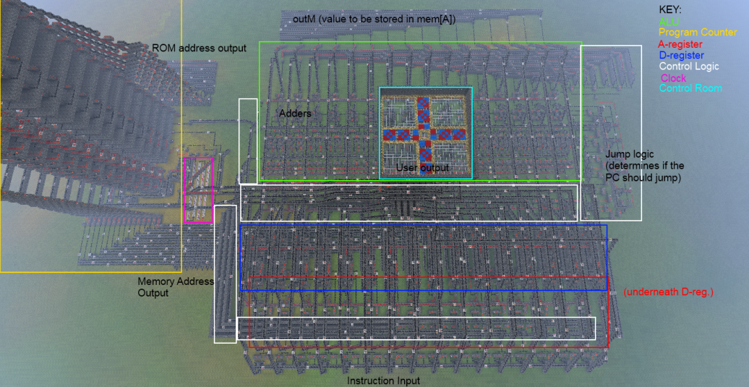
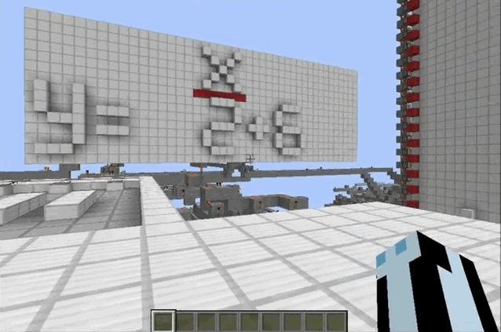
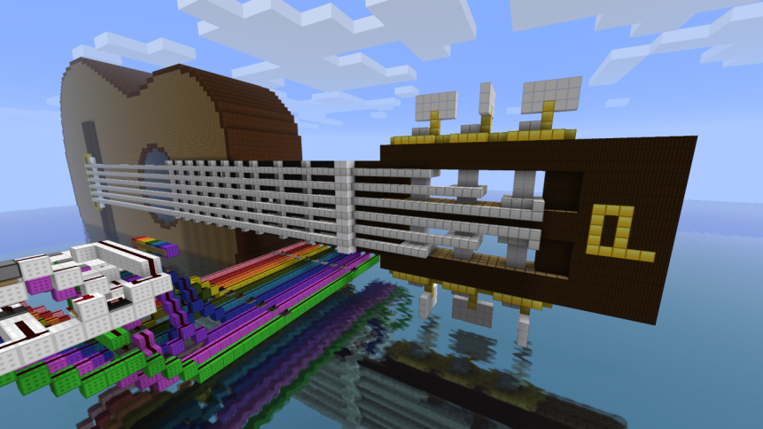
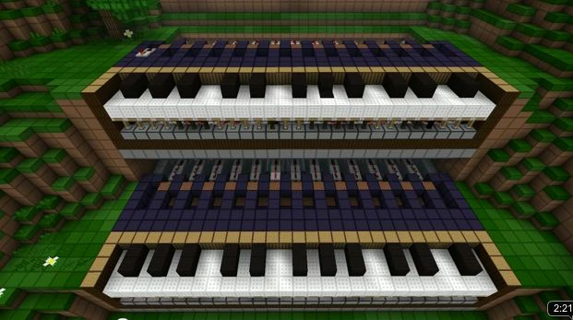
Things Built
Working computers, calculators, instruments…
Notes:
Redstone wiring allows AND, OR, flip-flops, clock cycles, etc.
You can make the guitar play by standing on different plates for various chords. The frets also depress to show the fingering.

Slide 8
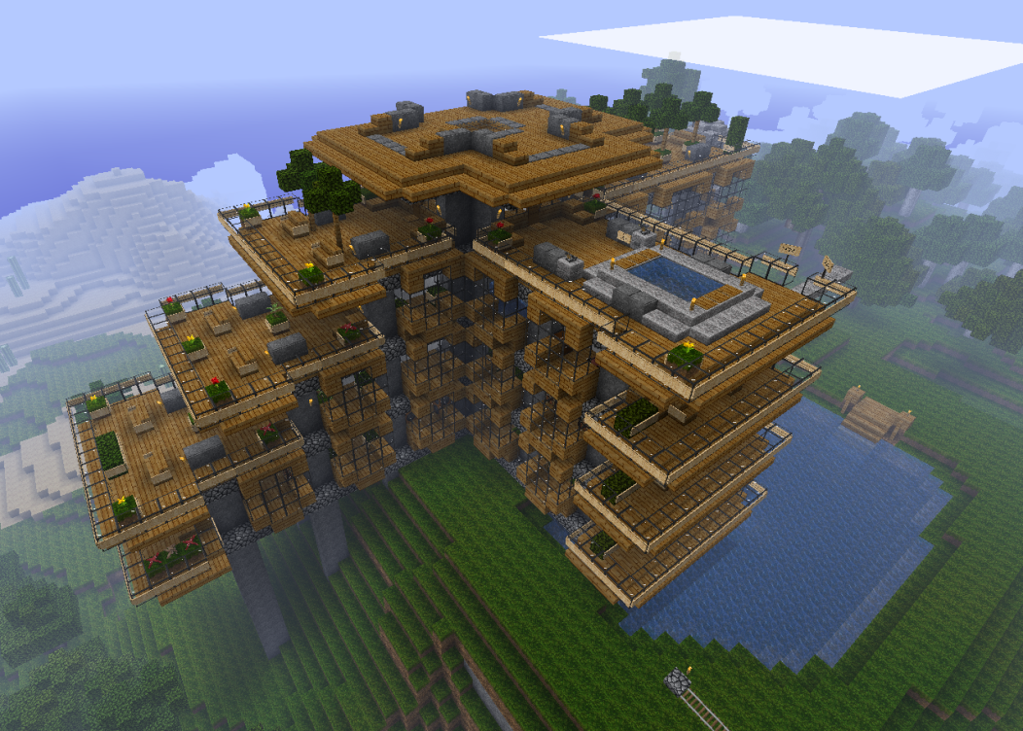
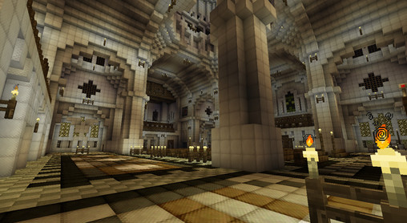
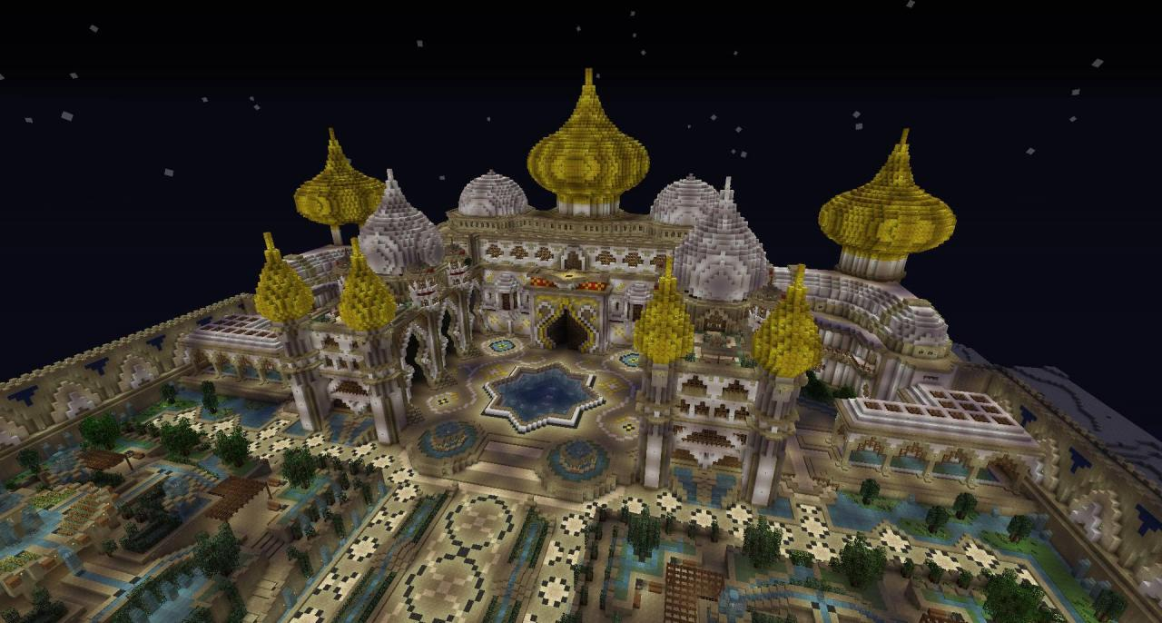
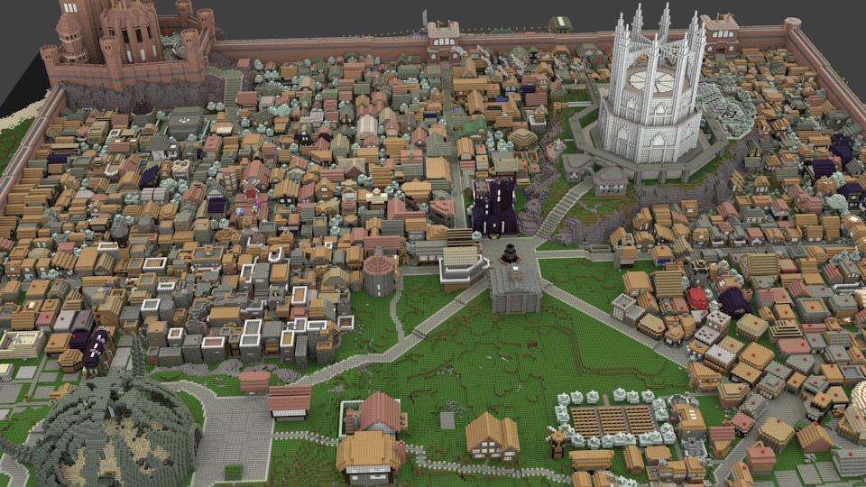
Things Built
and many, many buildings
Notes:
Every user is an architect

Slide 9
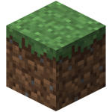
Popularity
Minecraft has:
30+ million registered users architects
6+ million people have bought the game
  $200K to $350K a day, not including handheld market
255 million pages found by Google
5.3 million YouTube videos
88,250 projects, 12,582 texture packs, 2,968 code modifications/add-ons for download
- and that’s on just one community site
Notes:
Original game developed by one person!
… and counting. Sales are for accounts on PCs, Mac, Linux; there are also sales on other platforms (handhelds)
Site is planetminecraft.com
Sales stats at http://www.minecraft.net/stats

Slide 10
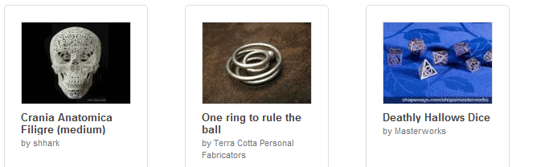
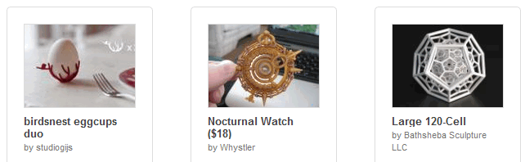
Shapeways
3D printing service provider, consumer-oriented. Some stats for the year 2011:
238,000 models uploaded by users
750,000+ models printed
$270,000 earned by shop owners
100,000+ community members
Notes:
There are others in the consumer field: Ponoko, i.materialise. Shapeways is much smaller scale than Mojang (developer of Minecraft).
Stats from http://www.shapeways.com/blog/archives/1155-A-Portal-into-the-Future-2011-in-Review,-and-Whats-to-Come.html

Slide 11
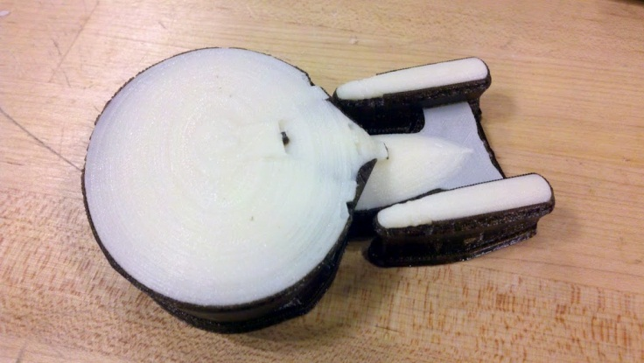
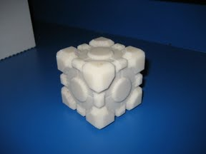
Precursors
Minecraft and 3D printing look like a great fit.
Minecraft.print() by two students at MIT:
Notes:
You are looking at their entire gallery.
Oddly, 16+ map viewers, 3+ model exporters for rendering, but only one experimental 3D print exporter.

Slide 12
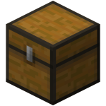
Smoke, But Little Fire
Minecraft.print() made a big splash in July 2011, but had very few adopters, due to limitations:
You had to mark the 3D selection by actually going into the world and placing (rare) blocks.
You had to install and run Python.
The output STL file had no colors.
There was little guidance as to what to do next, i.e., how to get a print.

Slide 13
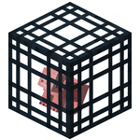
Mineways.com
Registered in May 2011, but I got distracted.
Why make a program?
  Minecraft is fun, 3D printing is fun, programming is fun, so this project should be fun-cubed.
  The Minecraft community is a participation-based culture. So, for the honor/ego-boost/karma.
  The MIT guys hadn’t continued their efforts, it’s like they were going to school or something.
  Why not?
Notes:
I’ve heard we often do stuff, then later figure out our motivations. What we say is often “post hoc” and not our real motivations.

Slide 14
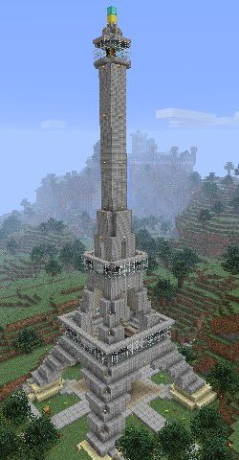
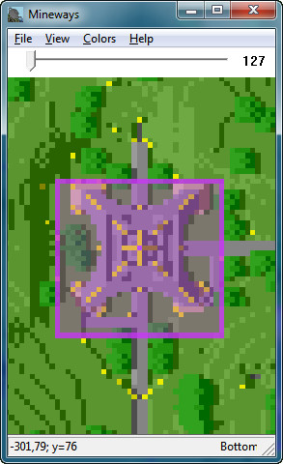
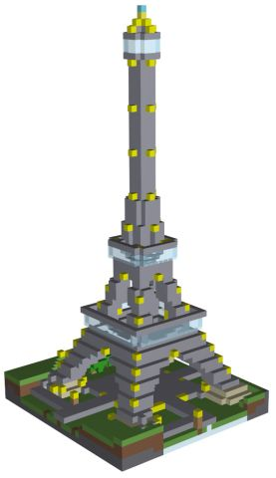
Demo
Notes:
Time permitting, do a demo here.

Slide 15
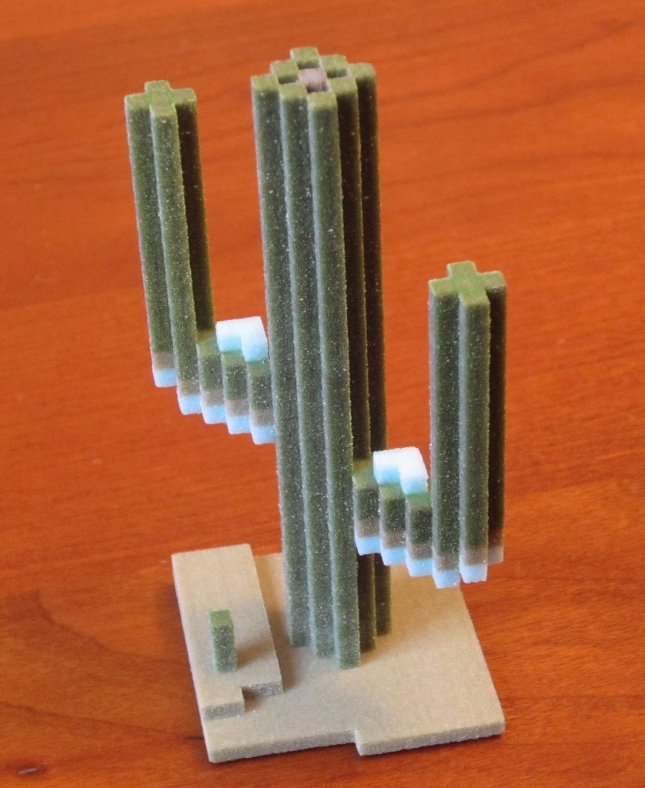
Mineways Goals
Interactive
Tight iteration: select,
examine, modify
Color export
Automatically fix any
mesh print problems
Easy model upload
Notes:
I’ll now go into each area in some depth

Slide 16
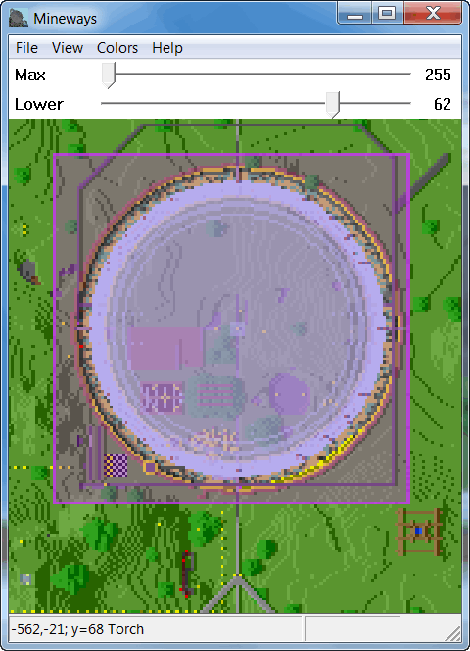
As Interactive as Possible
Avoid command line
But, user interface coding is a pain (to me)
Solution: open-source mapping program, “minutor”
Notes:
It’s a 2D solution, but it’s much more intuitive and precise. A 3D in-program preview would have been nice.
Missing: grips on the selection rectangle

Slide 17

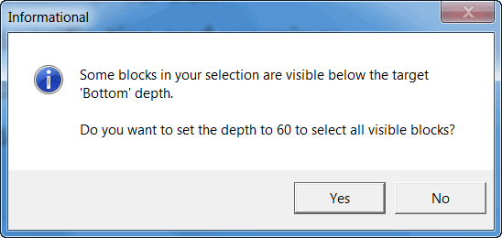
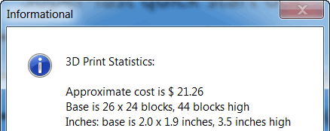
Help the User Along
Super-fast quick start doc
Adjust bottom of 3D box
Context specific tips and warnings
Good progress bar (no “99%” for 2 minutes)
Show cost on export, not after upload
Notes:
These all sound obvious, but a few were added over time: automatic depth, some warnings, and print cost

Slide 18
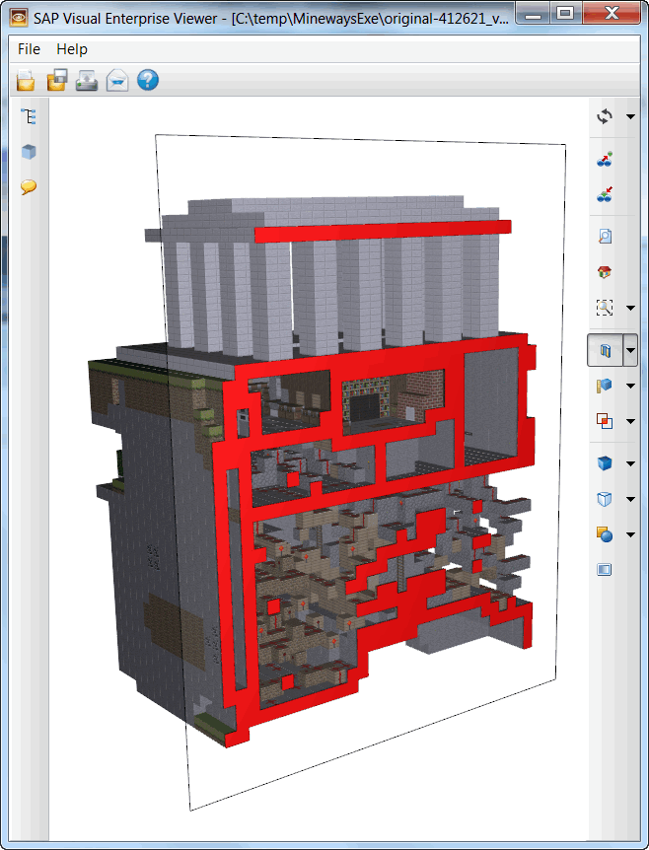
Tight Integration
Select, export, view,
modify, export
Use existing VRML viewer →
Resizeable selection
Trivial world reload

Slide 19
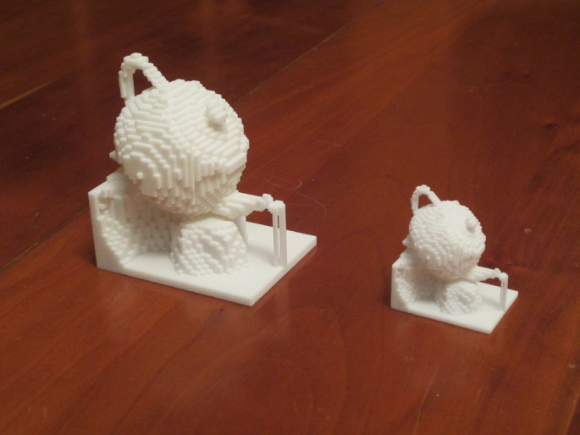
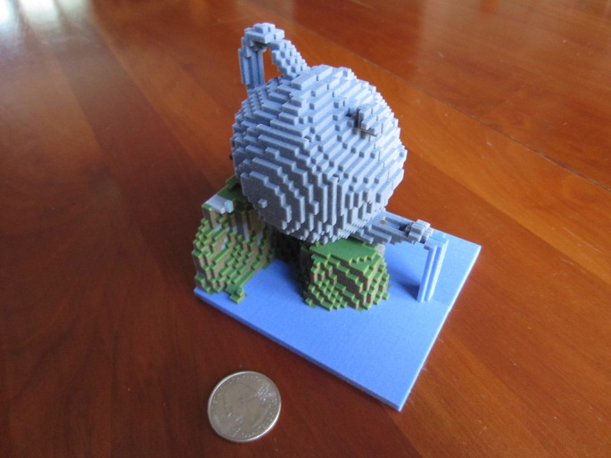
Color Export
Challenges included:
STL has two different color formats
Shapeways’ website misleading about OBJ
Solution: VRML, following the MeshLab export format

Slide 20
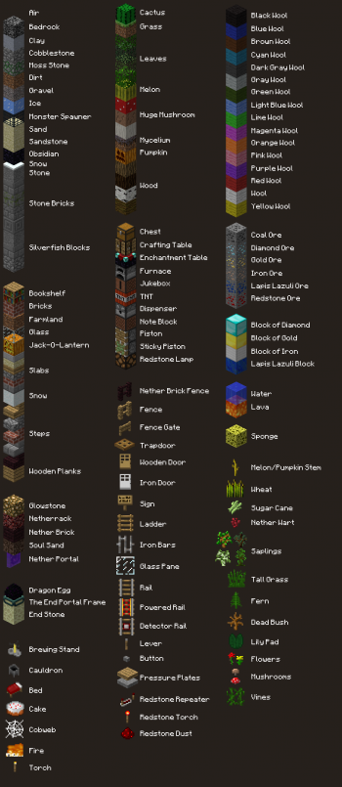
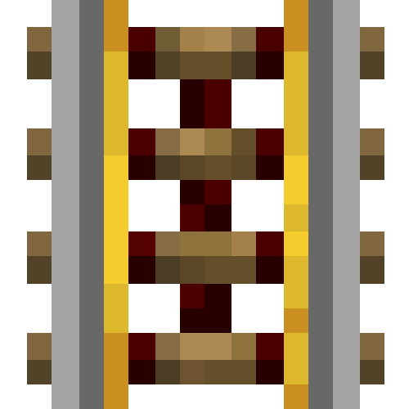

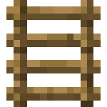
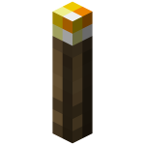

Textures: A Tedious Business
127+ block types, plus variants
Some blocks are like decals:
Solution: create decal & background combinations
Notes:
Also, for 3D printing currently you have to use one single texture for the model, so must mosaic all combinations. There’s a whole decal library made on the fly.

Slide 21
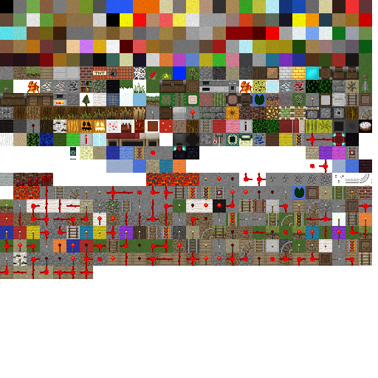
A Typical Output Texture
Solids →
Textures →
Decals →
Notes:
Each 16x16 texture is expanded to 18x18

Slide 22
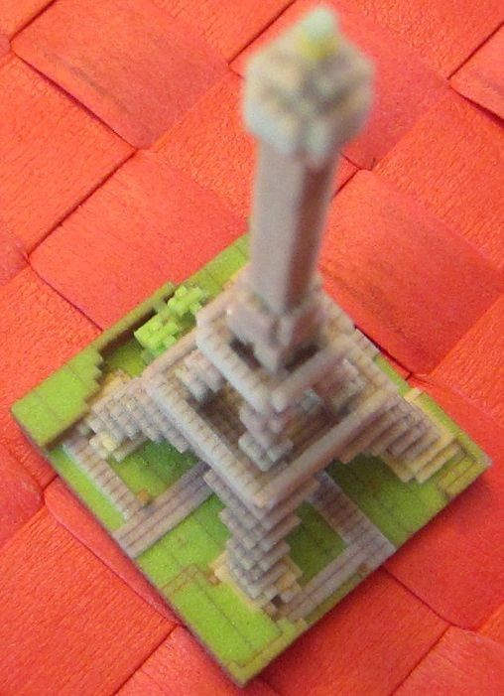
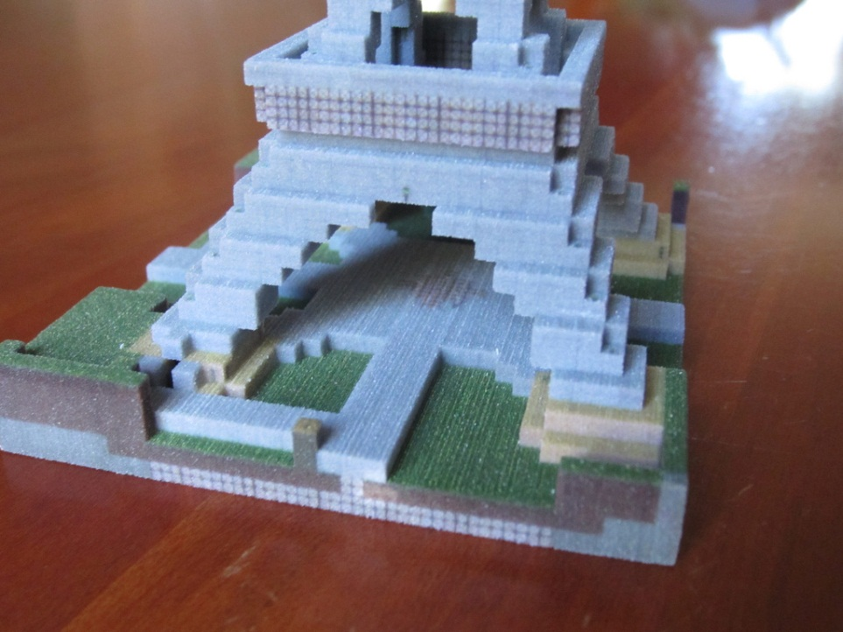
ZPrinter Texture Interpolation
3D Printer uses bilinear interpolation. Fix: make 16x16 tiles be 18x18.
Notes:
Print on right is FigurePrints, who currently have this problem. Mineways is on left.

Slide 23
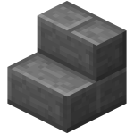
Mesh Cleanup and Healing
Problems include:
Lack of gravity
Not all blocks are cubes
Watertight surfaces
Cost (without hollowing)
Wall and column thickness
Minutiae: filling in tunnels, entrance sealing, tree removal, options to remove glass, etc.
Notes:
I’ll go into some details about each of these

Slide 24
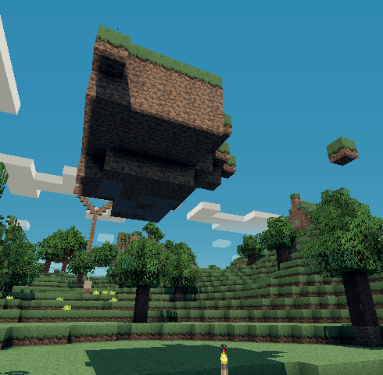
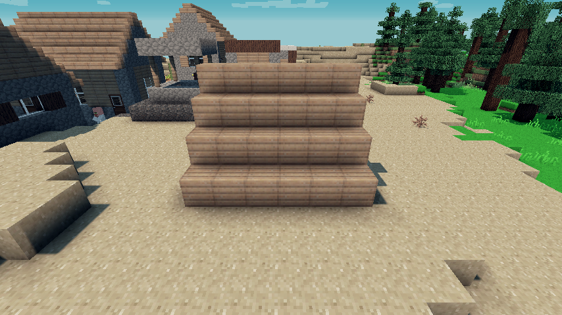
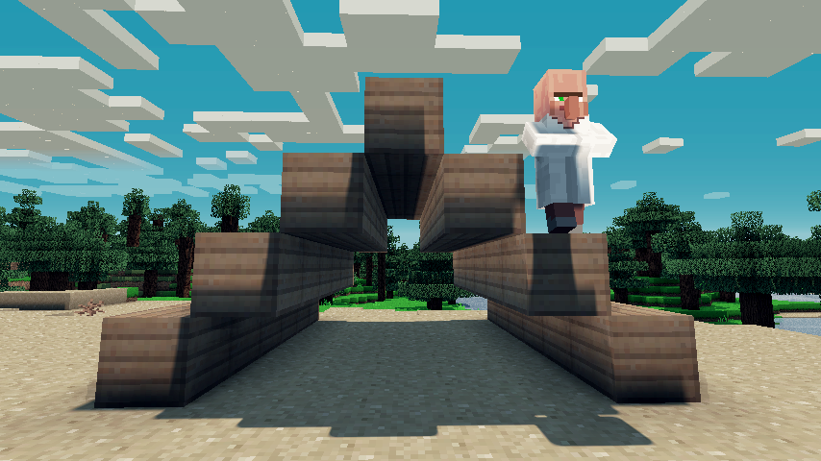
Floating Object Problem
Some obvious problems, some not so obvious
Notes:
Floating islands won’t export well. Well, they will, but they won’t float any more. Surfaces can be formed that do not connect.

Slide 25
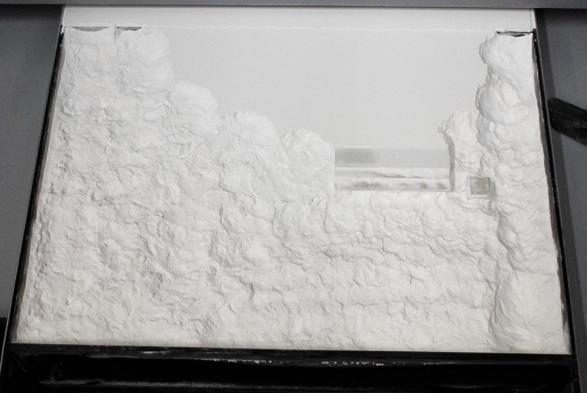
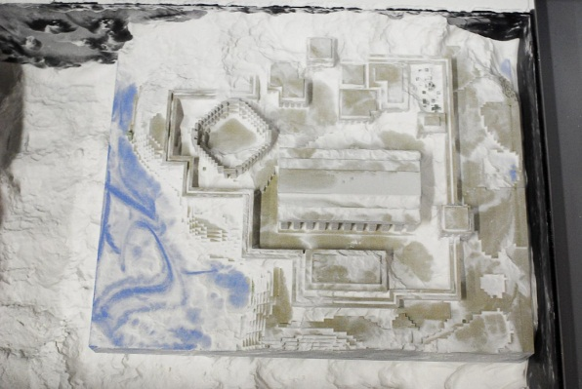
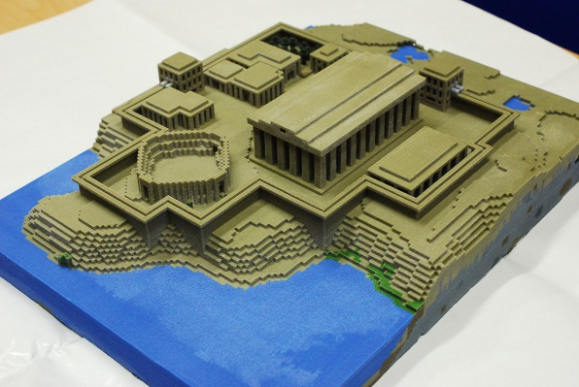
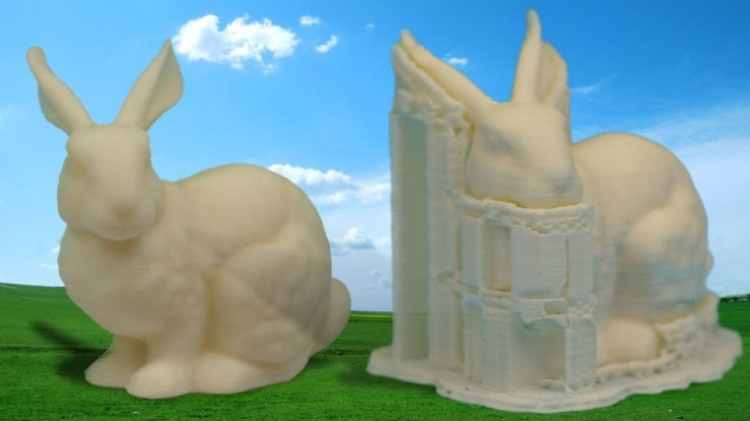
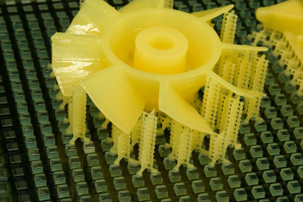

Floating Can Be Fine
Shapeways’ printers need no support structures:
Lower-end or specialized printers do:
Notes:
No support structures are needed because the printer prints a layer at a time. The unsolidified material supports the layers above it.

Slide 26

“3D Printing” Looks So Easy
Notes:
I consider 3D printing to be manufacturing, not printing. “Printing” implies it’s like 2D printing, which is very easy nowadays.

Slide 27

Additive Manufacturing
The first part is like printing, it lays down layers:
Notes:
I consider 3D printing to be manufacturing, not printing. “Printing” implies it’s like 2D printing, which is very easy nowadays.

Slide 28

Then Subtractive
Then you dig your model out:

Slide 29

More Subtraction
Then vacuum it:

Slide 30

A Bit More
Then clean with pressurized air:

Slide 31

The Last Step
Then douse with superglue. It’s just that easy!

Slide 32

Floating Object Solution
Detect floating objects:
Find all object groups: solid blocks connected by faces, i.e. 6-connected voxels. Use seed fill.
Check if groups touch on edges or corners.
If a group is not eventually connected to ground, delete if small, else warn user.

Slide 33



Floating Object Debug
Show the user what objects are floating – the “ground” objects are transparent.
Notes:
The floating foliage piece is something the user would decide is worth deleting

Slide 34

Manifold (Watertight) Surfaces
Shapeways requires that you avoid having an edge shared by two separate solids.
In reality, they will almost
always accept and print
models with shared edges.
This is good, as fewer
blocks are then added.
Notes:
Of course, the model itself must be watertight otherwise.

Slide 35



Touching Groups
If a group does touch another group, add blocks to join the groups. Also a debug display mode:
Notes:
Lava is connections by edges, pick wool by corners. The user could also always go into the world and fix things “by hand”.
Blocks are added, vs. adding thin beveled connectors of edges, etc., as you want the thickness for strength (plus it’s easier to code, by far).
Adding blocks also looks more natural, vs. adding geometry that you’d never see in the game itself.

Slide 36



Don’t Print What You Can’t See
Hollowing can cut costs by 3x or more.
My trick is to fill in all interior “bubbles” found, then hollow out the single solid mass.
Notes:
Finding the surface polygons once done is easy enough: just look at each cell and its six neighbors (really, three neighbors – you want to look at each neighbor pair just once). If one side is solid and the other side is air, then create a square there and add the proper texture.

Slide 37

Thickness Requirements
Various rules of thumb:
Tricky to detect!
Partial solutions:
Export at 2 mm/block, a safe thickness for walls.
Allow smaller blocks, but safely hollow.
Give user warnings, solutions, tutorials.

Slide 38

Final Answer: Horrifying Dialog
But, the norm is “hit OK”. Defaults are carefully chosen.
Could be made a separate menu item, but it’s honestly easier to hit “OK” (or Enter key).

Slide 39

Shapeways Upload Example
Shapeways accepts a .zip file of the model and texture.
Upload is
pretty easy: .zip and title.

Slide 40

Setting Up Shop
Is a bit of a pain: the Shapeways “live web page” is slow to update, a bit tedious to edit. Still, just a few minutes to do.

Slide 41

Upload Problems
Users often upload VRML file instead of ZIP
Solution: export only the ZIP by default
Shapeways has an API to upload a model to their website.
  Minetoys uses it – fine for small models.
Uploads still sometimes fail, often with little feedback from Shapeways.
Notes:
Uploading a large model via the API seems scary – if something goes wrong, it’ll just look like a lock-up.
Minetoys is a company that 3D prints character models.

Slide 42

Smoke…
Launched on reddit on Christmas Eve 2011. Upvoted!
YouTube video: 2 minutes from installation, to export, to preview, to model upload.
Video gets 90K views in a week.
Engadget and others blog it January 3rd, another 75k views.
Notes:
The original video is up to 180k views. Nice, but most Minecraft players have probably never heard of the program at this point.

Slide 43

… and Some Fire
20,000+ downloads of the program to date.
Hundreds, maybe thousands, of model uploads to Shapeways (hard to track without using Shapeways’ API).
Volunteer helps port the program to the Mac by using WINE.
Many YouTube and webpage tutorials are created by users, in many languages.
Notes:
Eastern Europeans in particular seem to like Mineways.

Slide 44




Some Examples
Sentinel Castle, by Mauricio Vives World in a Bowl, by Nefashu

Slide 45




Still More Examples
Olympic starship, by Momentaneously Chainlandia, by combineelite
Notes:
The starship is actually two separate prints, the struts to the nacelles are sturdy plastic. The chain has objects floating in the world, so no gravity can be a help.

Slide 46















And More
Notes:
See mineways.com for credits. I should probably have these “march” off the right edge of the page by adding 6 more.

Slide 47

Open Source For The Win
Using “minutor” saves me a lot of time.
Bonus: I collaborate with minutor’s creator.
Double bonus: outside user submits fix when Minecraft world format changes.

Slide 48



Not a Perfect World
Initial message missed the mark for some:
“I don’t have a 3D printer”
“That big print shown in that video cost $630”

Slide 49

Not a Perfect World, part 2
Bugs turned some people off: you get one shot with the consumer
Biggest bug of all: multibyte character path names.
  Umlauts and spaces in path and file names.
  Multibyte characters not supported by VRML or OBJ file formats; need a good translator.
  VRML supports spaces in filenames, Shapeways does not.
Notes:
Don’t use Microsoft’s multibyte to byte converter, it does bad stuff.

Slide 50

Still and All, A Fun Thing
Image made with Arnold, by Estopero. To appear on the cover of “3D Artist” magazine.
Notes:
When it appears on the cover, the Mario and Luigi on the left will be gone – the magazine was concerned about legal issues.

Slide 51

Competition == Success
Notes:
First sighted 4/19/2012. I like to think you’ve succeeded making something new if someone else tries to copy it.
Figureprints.com – I’ve been helping the creator, Ed Fries, debug his program.

Slide 52



A Practical Use
Northwestern University Campus, by Ben Rothman
Notes:
http://www.northbynorthwestern.com/story/student-recreates-north-campus-in-minecraft/
Pictures at http://benthemonkey.imgur.com/

Slide 53

A Practical Use
Ford Engineering Design Center, by Ben Rothman

Slide 54

A Practical Use
Ford Engineering Design Center, by Ben Rothman

Slide 55

A Practical Use
Ford Engineering Design Center, by Ben Rothman

Slide 56



The Appeal of Voxels to Users
Ease of use: everyone knows how to stack blocks
Understandable: maps to real-world
Precise
More elaborate tools available as desired, e.g. VoxelSniper, WorldEdit
Notes:
It can be a lot easier to create something amazing in Minecraft than 3ds Max. A huge number of people are unleashing their otherwise dormant creativity with Minecraft.
More from Ben Rothman: http://imgur.com/a/kaEaC

Slide 57


The Appeal to Programmers
Simple, simple, simple:
Uniform size and grid fits data structures
Cellular rules for checking properties
Efficiency via octrees, etc.
Voxel rendering well-researched

Slide 58


Maybe a Modeling Paradigm?
Minecraft has the most active mod community of any game, ever. Kinect as model capture:
Notes:
http://www.orderofevents.com/MineCraft/KinectInfo.htm

Slide 59

My Takeaways
Ease of use is absolutely key
  When poor, only dedicated users are involved
3D printing is pricey, and the color material (“sandstone”) is brittle
  Atoms evolve slower than electrons
Voxels are easy to program and use
Community involvement – open-source, mod making, texture creators, 3D artists – makes for more success & happiness

Slide 60


Questions?

Slide 61

Notes
Mineways is at http://mineways.com
Minecraft is at http://minecraft.net
Shapeways is at http://shapeways.com
This presentation uses images under Fair Use for educational purposes. The images should not otherwise be reused or distributed without permission from the owners.

